Slide 1
COMPe4Mi – Tools for Tools for professionals to assess and develop migrants’ competences
Partnership:

Slide 2
Presentation Outline
Introduction - Summary of Functional Requirements
Users View
Registration & Login
Accessing Training Material
Tests
Forums
Administrator View
Adding/Editing Material

Slide 3
Presentation Outline
Introduction - Summary of Functional Requirements
Users View
Registration & Login
Accessing Training Material
Tests
Forums
Administrator View
Adding/Editing Material

Slide 4
Introduction - Summary of
Functional Requirements
Functional requirements define a function of a system or its component, where a function is described as a specification of behavior between outputs and inputs.
FR Specification Document has already been disseminated and agreed
Changes that contradict the agreed Functional Requirements are impossible to be implemented

Slide 5
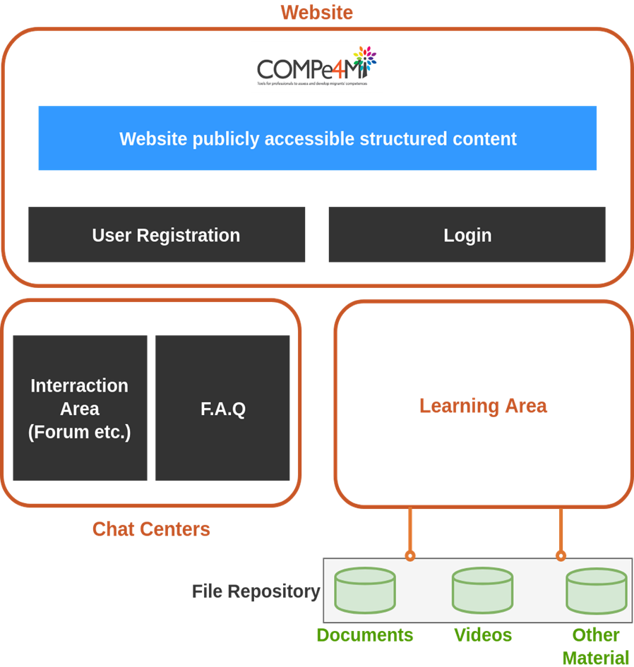
Architecture

Slide 6
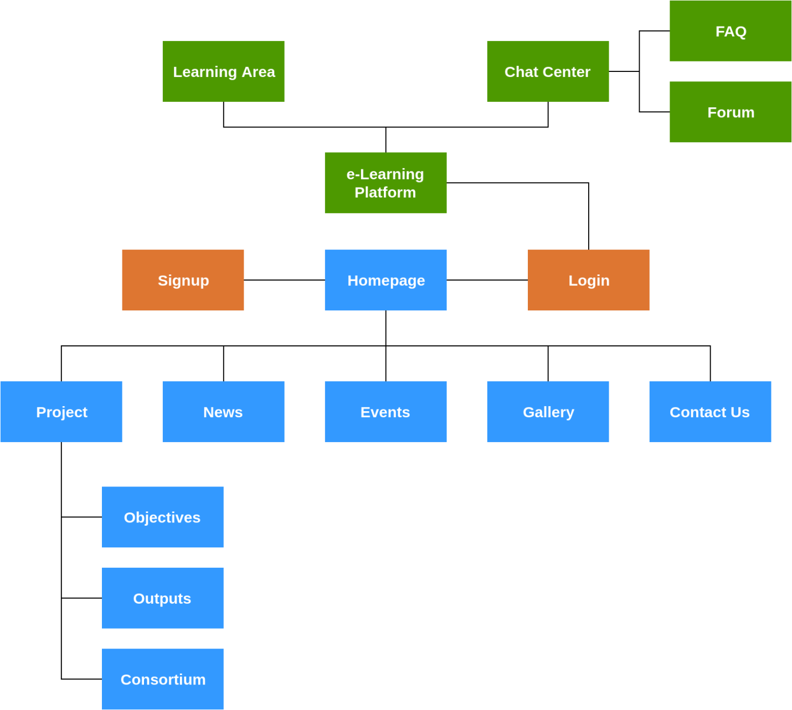
Platform and Website Structure

Slide 7
Presentation Outline
Introduction - Summary of Functional Requirements
Users View
Registration & Login
Accessing Training Material
Tests
Forums
Administrator View
Adding/Editing Material

Slide 8
Users View
Users view is where the registered users interact with the platform
Registered Users → Users that have registered with a valid email address to the platform. By using their credentials (username which is usually the email address and password) they can login to the members only area of the platform
Interact → Interaction is defined as a set of actions that a user performs on the platform. Usually these action require some kind of input from the user and the platform produces an output. Actions = Functionalities (Functional Requirements)

Slide 9
Login
Login is the process based on which a guest user will use his valid credentials (username, password) created during the registration process in order to access the private areas of the platform.
How to login:
Visit: http://portal.compe4mi.eu/account/login
Enter credentials
Click login

Slide 10
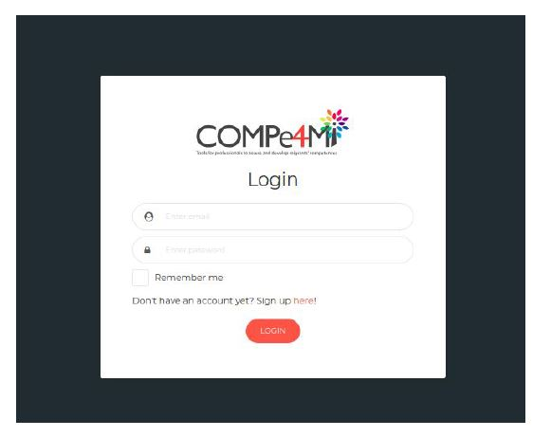
Login

Slide 11
Register
Register (Registration) is the process which allows the user to create valid credentials by providing an active email and selecting a password. The credentials will allow the user to login in the private areas.
How to register:
Visit http://portal.compe4mi.eu/account/register/
Fill in the registration form (valid email address is required)
Activate your account. An email is being sent to the provided email address

Slide 12
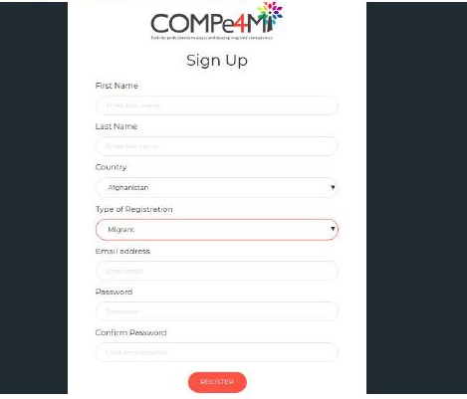
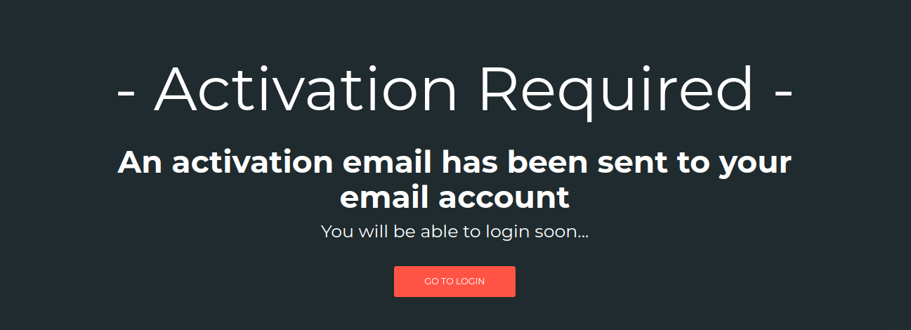
Register

Slide 13
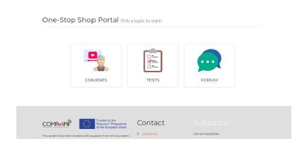
Platform Home Page
When the user logs in he/she then is redirected to the home page of the platform. As seen in the picture below he/she will be able to navigate through all areas of the portal.

Slide 14
Access Training Material
By clicking on ‘Courses’ (from top menu or main icon) you are then redirected to the list of available courses offered on the platform. To view more details about a course simply click on the course card.

Slide 15
Courses Details
All necessary Course information are displayed as shown in the figure below.
Course Files appear as links under the modules.
COURSE
COURSE MODULES
COURSE FILES

Slide 16
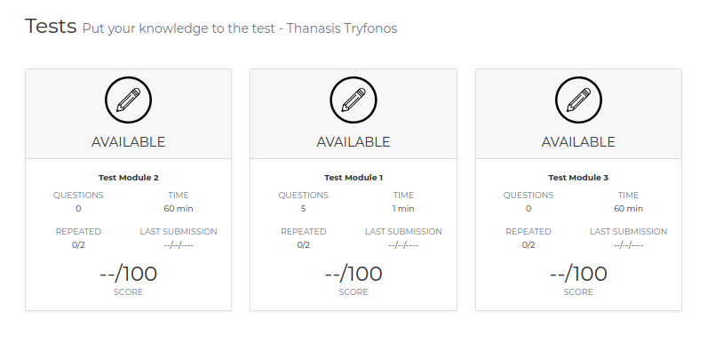
Tests
Navigating to the tests area you will see the list of available tests. For each test the user can see how many questions there are in each test, the time needed to submit a test, number of repetitions, submission date and score.

Slide 17
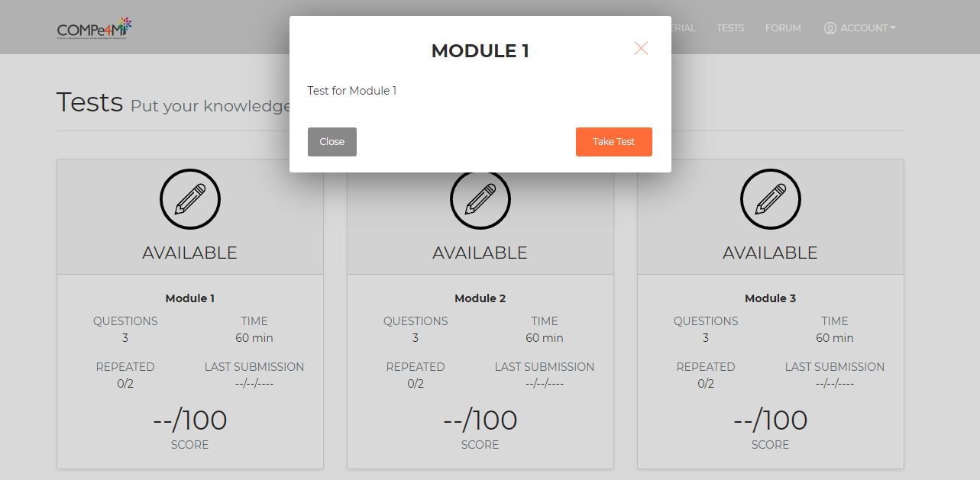
How to take a test
Click on a test card and a message box appears with the description of the test. If the user wants to take the test he simply clicks on Take Test button

Slide 18
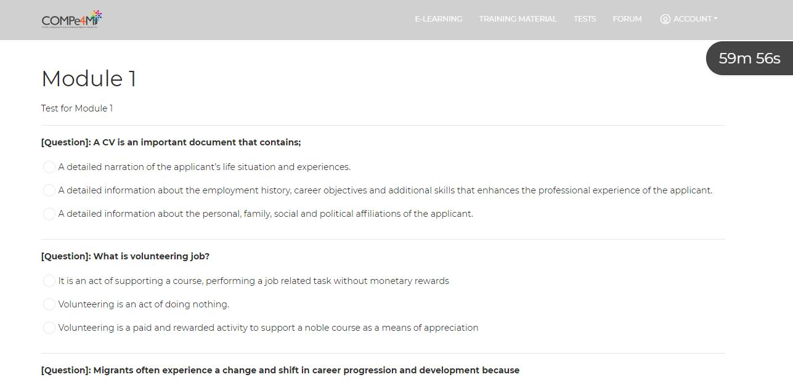
How to take a test
Each test has a timer that appears on top right corner. The user must submit a test before the time is up.

Slide 19
How tests work
In general the following rules apply for the tests:
A test is submitted only if the user clicks on the submit button
If the timer ends then the test is submitted as is at the time the timer ended.
If the user clicks exit, no matter what, it does not count as submission
Questions and possible answers of each question appear in random order.
For a test to be considered successful the user must accumulate at least 50% as a score
Scores are out of 100

Slide 20
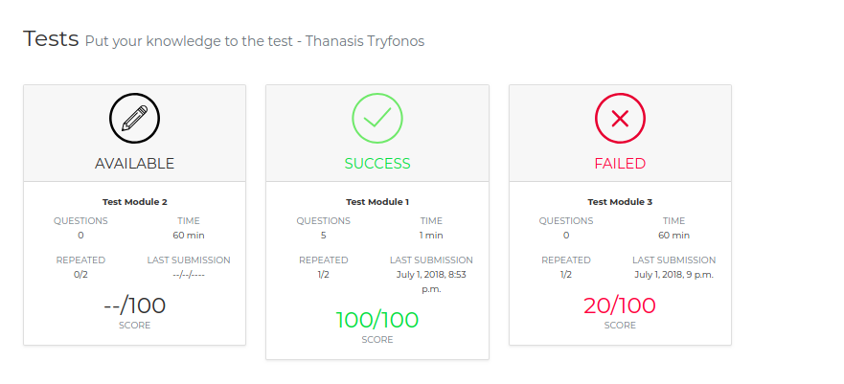
Submitted Tests
If a test is success then the user cannot take again the test.
If the user has failed 2 times in a test he cannot take again the test

Slide 21
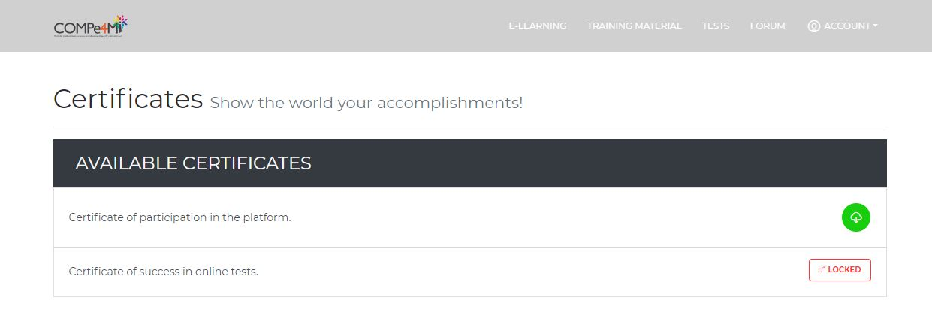
Certificates
By clicking on Top Menu > Account > Certificates User can view his vailable certificates for download (in pdf)
There are 2 types of certificates:
Certificate of participation
Certificate of successful test submissions

Slide 22
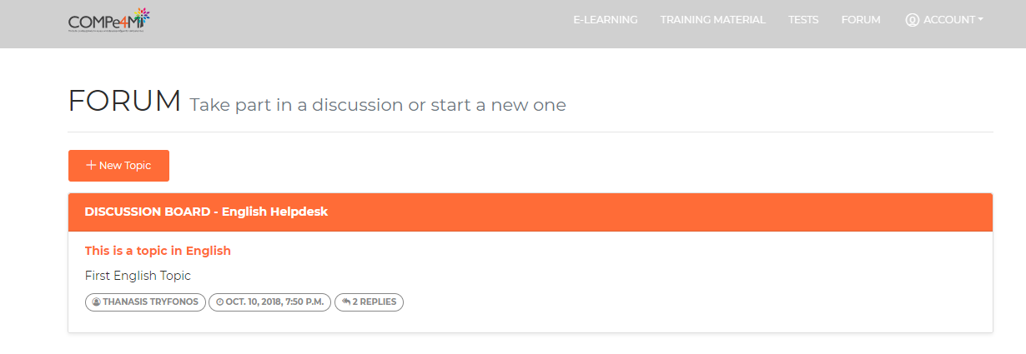
Discussion Boards
Navigating to the forum/helpdesk area there are boards where user can create topics and other users can comment

Slide 23
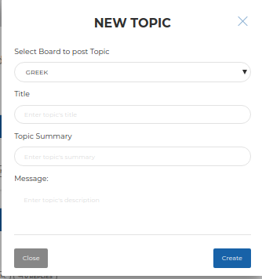
Add New Topic
Simply Click on the New Topic Button in the top left area and fill in the form

Slide 24
Reply to Topics
Click on a topic and you can read the discussion or even post a reply in the respective box.

Slide 25
Presentation Outline
Introduction - Summary of Functional Requirements
Users View
Registration & Login
Accessing Training Material
Tests
Forums
Administrator View
Adding/Editing Material

Slide 26
Administrator View
In order to have access to the admin area of the portal you will need to have an admin account.
ONLY ADMINS CAN CREATE ADMINS!!
Rules:
1 Admin Account per partner!
Visit the admin login area and just login using the provided email and password
http://portal.compe4mi.eu/admin

Slide 27
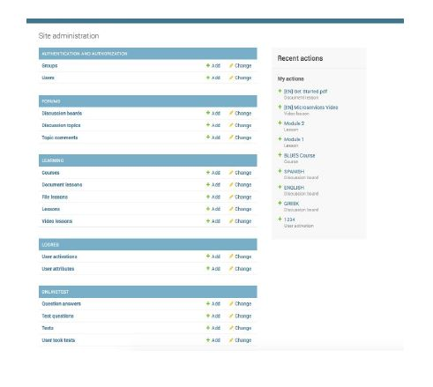

Slide 28
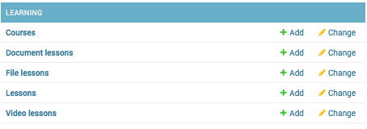
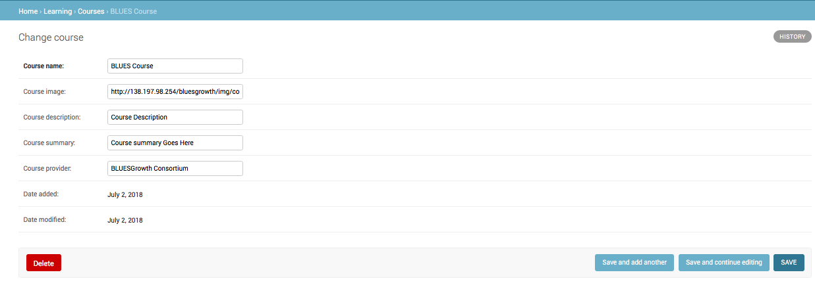
Create Courses
From the HOME page of the Admin, at the LEARNING category click on Courses
Fill in the requested info in the fields and click save

Slide 29
Create Course Modules/ Lessons
From the HOME page of the Admin, at the LEARNING category click on Lessons
Fill in the requested info in the fields and click save
From the dropdown select the course you are creating this module lesson to. Give a distinctive name and click save

Slide 30
Uploading Files/Videos
From the HOME page of the Admin, at the LEARNING category click on Document or Video Lessons
Fill in the requested info in the fields and click save
From the dropdown select the lesson you are creating this module lesson to. Give a distinctive name and at the url paste the url of the youtube video or the file url which is uploaded on some cloud (preferrably on google drive used by the consortium) click save

Slide 31
PAYMENT ARRANGEMENTS
Questions?
Questions?
This project is supported by the EU. Any communication or publication related to the Project made by the beneficiaries jointly or individually in any form and using any means, shall indicate that it reflects only the author's view and that the NA and the Commission are not responsible for any use that may be made of the information it contains.

Slide 32
Thank you!!!
Partnership:

